Slide 1
Project: Design XOR Gate
MARYAM ZUBAIR
STUDENT ID : 19709

Slide 2
Table of Content
Introduction
Explanation
NAND Gate
OR Gate
AND Gate
Conclusion

Slide 3
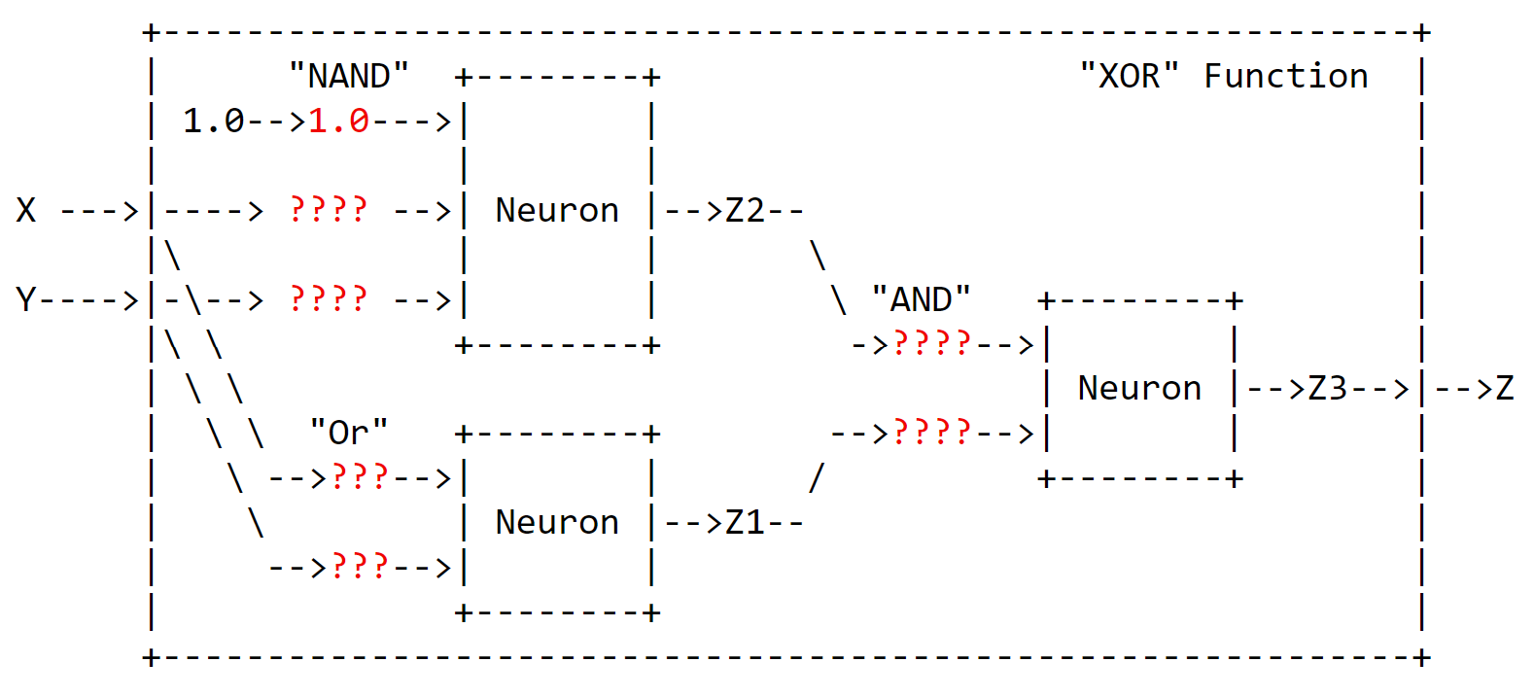
Introduction
The goal of this project is to design a neural network that can perform the XOR function using only NAND, OR and AND gates.

Slide 4
Explanation
To achieve the desired outcome, I first designed a hidden layer with two neurons that corresponds to NAND and OR gates. These neurons takes two inputs and produces an output using respective gates. Then, we are training the neural network for which we used Forward process and Backward process. Once the neural network was trained. Later used AND gate to combine the output of NAND and OR gate to produce the true XOR result.
Forward Process:
Calculating Output for given input
Backward Process:
Adjusting weight -> where on using specific weight if the actual output is lower than the desired outcome, I have increase the weight by 0,5 and if the actual output is greater than the desired output I have decreased the weight by 0.5

Slide 5
Explanation:
Formula used for calculating the output of a neuron :-
Z= (W0 * C + W1 * X + W2 * Y >= 1.0
W0, W1, and W2 = weight
W0 * C = Bias
X, Y =Inputs
Z = Output

Slide 6
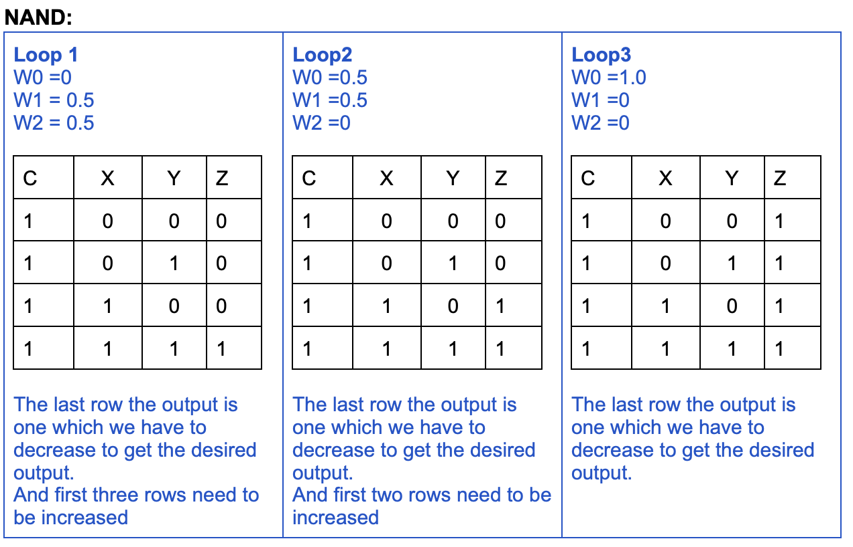
NAND Gate

Slide 7
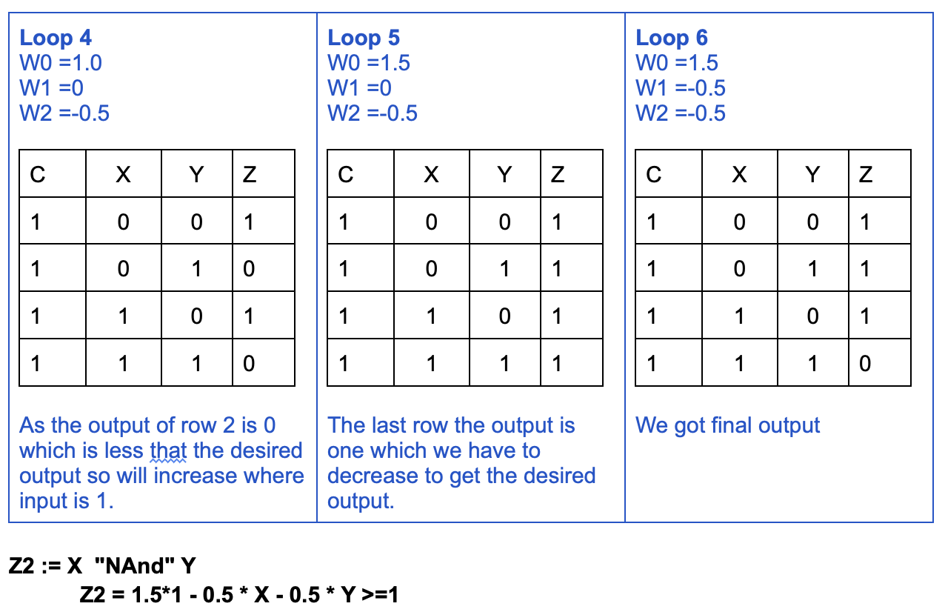
NAND Gate

Slide 8
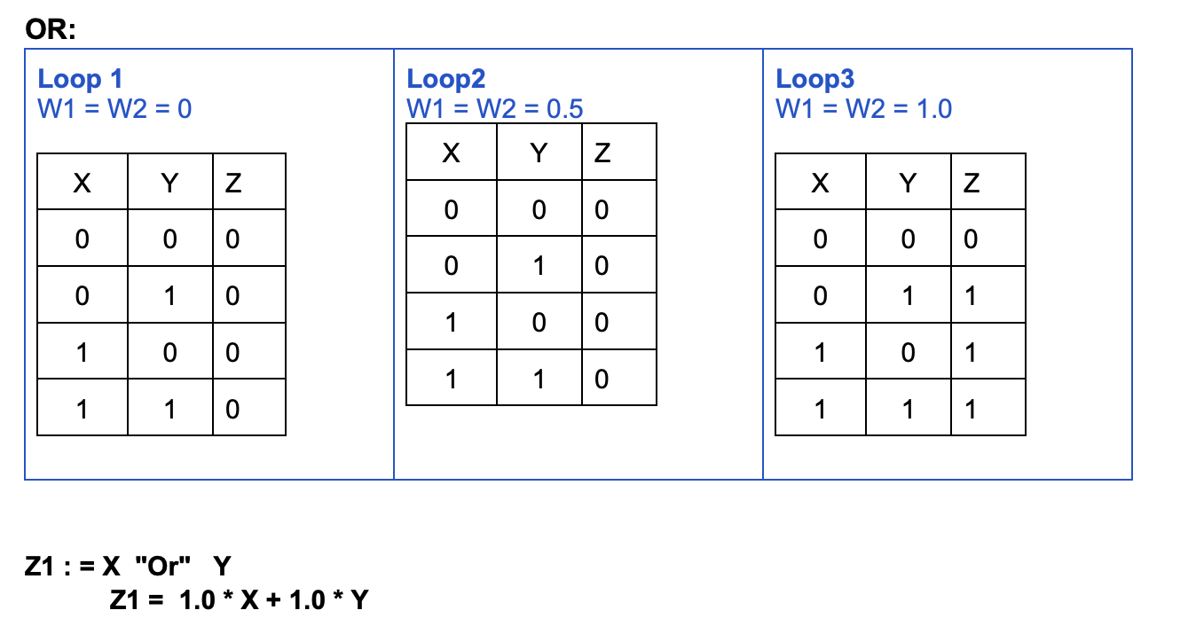
OR Gate

Slide 9
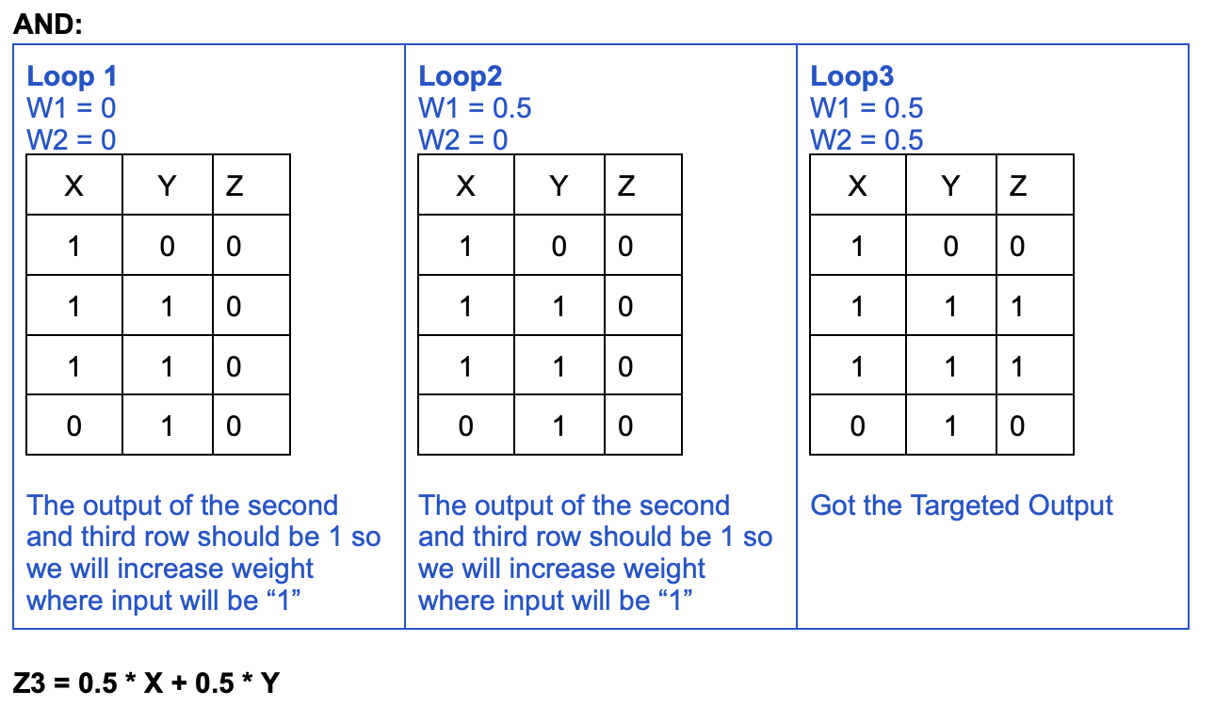
AND Gate

Slide 10
Conclusion
Z1 : = X "Or" Y
Z1 = 0.5 + 0.5 * X + 0.5 * Y
Z2 := X "NAND" Y
Z2 = 1.5 - 0.5 * X - 0.5 * Y >=1
Z := Z3 := Z1 "And" Z2 Z := ( X "NAND" Y ) "And" ( X "Or" Y )
Z =( 0.5 * ( 1.5 - 0.5 * X - 0.5 * Y > = 1.0 )) “and” (0.5 * ( 1.0 * X + 1.0* Y > = 1.0 ) > = 1.0)
XOR Designed Gate:
By adding the value of weight, we found above to see whether our designed XOR Gate give the desired output or not.
X | Y | Z (XOR)
0 | 0 | 0
0 | 1 | 1
1 | 0 | 1
1 | 1 | 0

